Slide 1
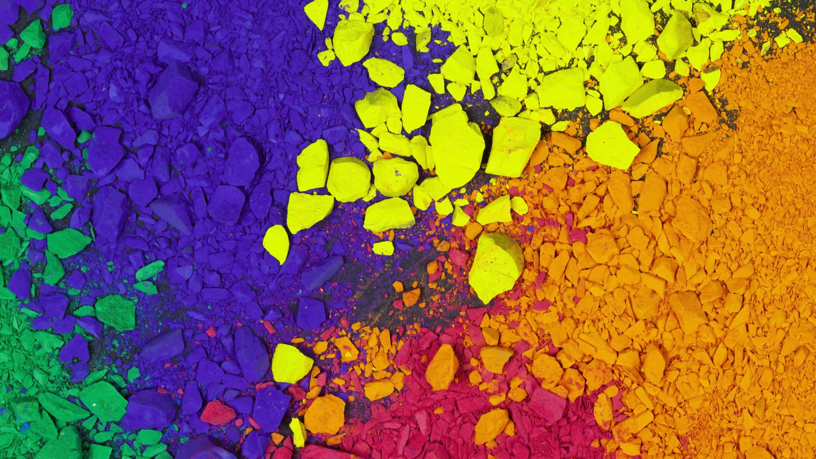


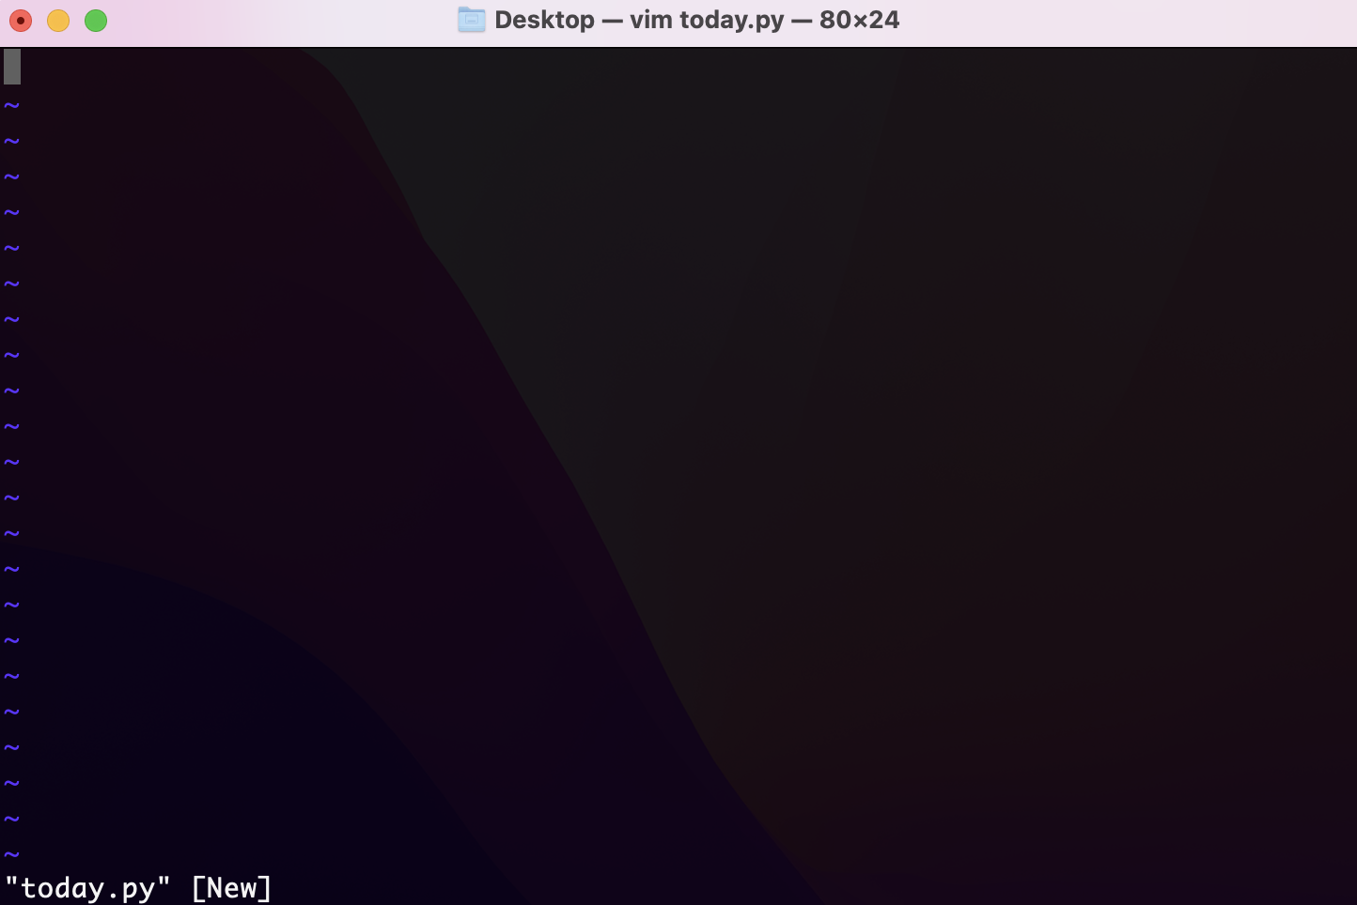
The color grabber Will Kennedy
Clicked at: (842, 391) RGB: (12, 48, 102) HEX: #0c3066 Detected Color: BLUE Blue often represents calmness, mystery, melancholy, isolation, sadness, and the vastness of the unknown Dark ocean blues can create feelings of fear, uncertainty, depth, and hidden danger beneath
Movies like The Abyss (1989) or Moonlight (2016) are great examples of how blue capture the wonder and horror of the ocean
https://github.com/ksu-is/Color-Grabber
Just input a picture and select an area and this program will tell you all about that color: What it’s called, what it’s used for, and where its used best in media!

